Slide 1
Doubly linked list

Slide 2
Insert into the front of the doubly linked list

Slide 3
Situation 1: No node in the list yet
void add_newnode_to_the_front_doublylist(int book_id, string title, string author, string book_details)
{
newnode = new book;
newnode->book_id = book_id;
newnode->title = title;
newnode->author = author;
newnode->book_details = book_details;
newnode->nextaddress = NULL;
newnode->prevaddress = NULL;
if (head == NULL)
{
head = tail = newnode;
}
else
{
newnode->nextaddress = head;
head->prevaddress = newnode;
head = newnode;
}
}
1200
1200
Prev
24
Next
head
1200
newNode
tail

Slide 4
Situation 2: At least 1 node in the list
void add_newnode_to_the_front_doublylist(int book_id, string title, string author, string book_details)
{
newnode = new book;
newnode->book_id = book_id;
newnode->title = title;
newnode->author = author;
newnode->book_details = book_details;
newnode->nextaddress = NULL;
newnode->prevaddress = NULL;
if (head == NULL)
{
head = tail = newnode;
}
else
{
newnode->nextaddress = head;
head->prevaddress = newnode;
head = newnode;
}
}
1200
1200
Prev
24
Next
head
1200
tail
3200
3200
Prev
66
Next
newNode

Slide 5
1200
3200
3200
Prev
24
Next
Prev
66
Next
head
1200
4200
tail
4200
Prev
15
Next
newNode
else
{
newnode->nextaddress = head;
head->prevaddress = newnode;
head = newnode;
}

Slide 6
View from the end of the list

Slide 7
void view_from_end()
{
current = tail;
while (current != NULL)
{
cout << current->book_id << " - " << current->title << " - " << current->author << " - " ;
cout << current->book_details << endl;
current = current->prevaddress;
}
}
3200
1200
4200
4200
Prev
66
Next
Prev
24
Next
Prev
15
Next
head
1200
tail
current

Slide 8
View Book Detail in Single Page.
Move Forward and Move Backward

Slide 9
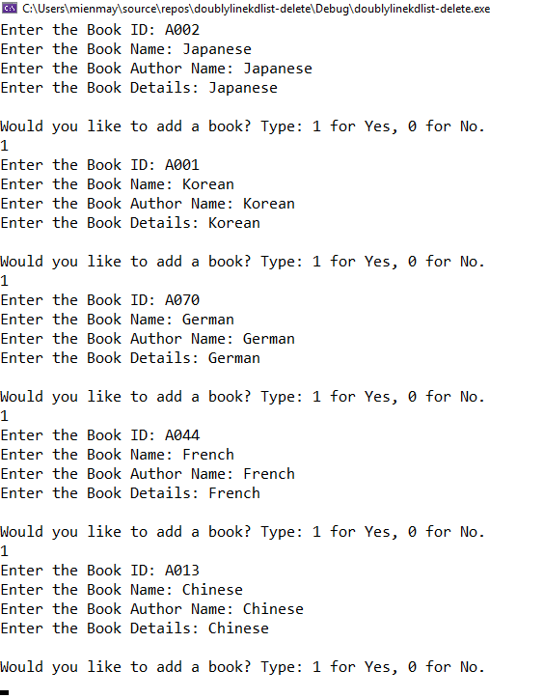
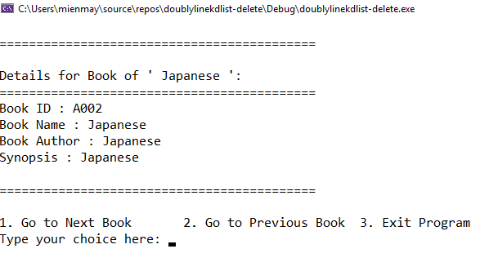

Slide 10
//display items page by page
current = head;
decision = 1;
while (decision != 3)
{
system("CLS");
cout << "\n===========================================\n";
cout << "\nDetails for Book '"<< current->book_id << "' :";
cout << "\n===========================================\n";
cout << "Book ID : " << current->book_id << endl;
cout << "Book Name : " << current->title << endl;
cout << "Book Author : " << current->author << endl;
cout << "Synopsis : " << current->book_details<< endl;
cout << "\n===========================================\n";
cout << endl;
cout << "1. Go to Next Book\t 2. Go to Previous Book\t 3. Exit Program\n";
cout << "Type your choice here: ";
cin >> decision;
switch (decision)
{
case 1:
if (current->nextaddress != NULL)
{
current = current->nextaddress;
}
else
{
cout << "End of list!" << endl;
system("Pause");
}
break;
case 2:
if (current->prevaddress != NULL)
{
current = current->prevaddress;
}
else
{
cout << "End of list!" << endl;
system("Pause");
}
break;
case 3:
cout << "Goodbye!" << endl;
exit(0);
}
}

Slide 11
Insert into the end of the doubly linked list

Slide 12
Situation 1: No node in the list yet
void add_newnode_to_the_end_doublylist(int book_id, string title, string author, string book_details)
{
newnode = new book;
newnode->book_id = book_id;
newnode->title = title;
newnode->author = author;
newnode->book_details = book_details;
newnode->nextaddress = NULL;
newnode->prevaddress = NULL;
if (head == NULL)
{
head = tail = newnode;
}
else
{
newnode->prevaddress = tail;
tail->nextaddress = newnode;
tail = newnode;
}
}
1200
1200
Prev
24
Next
head
1200
newNode
tail

Slide 13
Situation 2: At least 1 node in the list
void add_newnode_to_the_end_doublylist(int book_id, string title, string author, string book_details)
{
newnode = new book;
newnode->book_id = book_id;
newnode->title = title;
newnode->author = author;
newnode->book_details = book_details;
newnode->nextaddress = NULL;
newnode->prevaddress = NULL;
if (head == NULL)
{
head = tail = newnode;
}
else
{
newnode->prevaddress = tail;
tail->nextaddress = newnode;
tail = newnode;
}
}
1200
1200
Prev
24
Next
head
1200
tail
3200
Prev
66
Next
3200
newNode

Slide 14
1200
3200
1200
Prev
24
Next
Prev
66
Next
head
1200
tail
4200
Prev
15
Next
4200
newNode
else
{
newnode->prevaddress = tail;
tail->nextaddress = newnode;
tail = newnode;
}

Slide 15
Delete from the end of the doubly linked list

Slide 16
3200
1200
4200
4200
Prev
66
Next
Prev
24
Next
Prev
15
Next
head
1200
3200
tail
void deletefromtheend()
{
if (head == NULL)
{
return;
}
current = tail;
tail = tail->prevaddress;
if (tail != NULL)
{
tail->nextaddress = NULL;
}
else
{
head = NULL;
}
cout << "Delete: Book with id " << current->book_id << endl;
delete current;
}
current

Slide 17
4200
4200
Prev
15
Next
head
4200
tail
void deletefromtheend()
{
if (head == NULL)
{
return;
}
current = tail;
tail = tail->prevaddress;
if (tail != NULL)
{
tail->nextaddress = NULL;
}
else
{
head = NULL;
}
cout << "Delete: Book with id " << current->book_id << endl;
delete current;
}
current

Slide 18
Delete from the front of the doubly linked list

Slide 19
3200
3200
1200
4200
4200
Prev
66
Next
Prev
24
Next
Prev
15
Next
head
1200
tail
current
void deletefromthefront()
{
if (head == NULL)
{
return;
}
current = head;
head = head->nextaddress;
if (head != NULL)
{
head->prevaddress = NULL;
}
else
{
tail = NULL;
}
cout << "Delete: Book with id " << current->book_id << endl;
delete current;
}

Slide 20
1200
1200
Prev
24
Next
head
1200
tail
void deletefromthefront()
{
if (head == NULL)
{
return;
}
current = head;
head = head->nextaddress;
if (head != NULL)
{
head->prevaddress = NULL;
}
else
{
tail = NULL;
}
cout << "Delete: Book with id " << current->book_id << endl;
delete current;
}
current

Slide 21
Insert into SortedList

Slide 22
Situation 1: No node in the list yet
//create new node
newnode = new book;
newnode->book_id = book_id;
newnode->book_details = book_details;
newnode->author = author;
newnode->title = title;
newnode->nextaddress = NULL;
newnode->prevaddress = NULL;
//insert:
//situation 1: list is empty
if (head == NULL)
{
head = tail = newnode;
}
1200
1200
Prev
24
Next
head
1200
newNode
tail

Slide 23
Situation 2: Newnode->bookid smaller than head->bookid
//create new node
newnode = new book;
newnode->book_id = book_id;
newnode->book_details = book_details;
newnode->author = author;
newnode->title = title;
newnode->nextaddress = NULL;
newnode->prevaddress = NULL;
//situation 2: book id smaller than the head book id - insert to the front
else if (converttoUpperCase(newnode->book_id) <= converttoUpperCase(head->book_id))
{
newnode->nextaddress = head;
head->prevaddress = newnode;
head = newnode;
}
1200
1200
Prev
24
Next
head
1200
tail
3200
3200
Prev
16
Next
newNode

Slide 24
Situation 3: Newnode->bookid more than head-> bookid & tail->bookid
1200
head
3200
3200
Prev
24
Next
Prev
16
Next
//create new node
newnode = new book;
newnode->book_id = book_id;
newnode->book_details = book_details;
newnode->author = author;
newnode->title = title;
newnode->nextaddress = NULL;
newnode->prevaddress = NULL;
//situation 3: book id bigger than head book id and tail book id - insert to the end
else if (converttoUpperCase(newnode->book_id) >= converttoUpperCase(tail->book_id))
{
newnode->prevaddress = tail;
tail->nextaddress = newnode;
tail = newnode;
}
1200
tail
4200
Prev
38
Next
4200
newNode

Slide 25
Situation 4: Newnode->bookid more than head-> bookid but less than tail->bookid
3200
1200
4200
head
3200
Prev
16
Next
Prev
24
Next
Prev
38
Next
//create new node
newnode = new book;
newnode->book_id = book_id;
newnode->book_details = book_details;
newnode->author = author;
newnode->title = title;
newnode->nextaddress = NULL;
newnode->prevaddress = NULL;
//situation 4: book id bigger than head book id but smaller than tail book id - insert to the middle
else
{
current = head->nextaddress;
while (converttoUpperCase(newnode->book_id) > converttoUpperCase(current->book_id))
{
current = current->nextaddress;
}
current->prevaddress->nextaddress = newnode;
newnode->prevaddress = current->prevaddress;
current->prevaddress = newnode;
newnode->nextaddress = current;
}
current
4200
tail
1500
Prev
27
Next

Slide 26
void inserttoSortedList(string book_id, string title, string author, string book_details)
{
//create new node
newnode = new book;
newnode->book_id = book_id;
newnode->book_details = book_details;
newnode->author = author;
newnode->title = title;
newnode->nextaddress = NULL;
newnode->prevaddress = NULL;
//insert:
//situation 1: list is empty
if (head == NULL)
{
head = tail = newnode;
}
//situation 2: book id smaller than the head book id - insert to the front
else if (converttoUpperCase(newnode->book_id) <= converttoUpperCase(head->book_id))
{
newnode->nextaddress = head;
head->prevaddress = newnode;
head = newnode;
}
//situation 3: book id bigger than head book id and tail book id - insert to the end
else if (converttoUpperCase(newnode->book_id) >= converttoUpperCase(tail->book_id))
{
newnode->prevaddress = tail;
tail->nextaddress = newnode;
tail = newnode;
}
//situation 4: book id bigger than head book id but smaller than tail book id - insert to the middle
else
{
current = head->nextaddress;
while (converttoUpperCase(newnode->book_id) > converttoUpperCase(current->book_id))
{
current = current->nextaddress;
}
current->prevaddress->nextaddress = newnode;
newnode->prevaddress = current->prevaddress;
current->prevaddress = newnode;
newnode->nextaddress = current;
}
}

Slide 27
Insert into Specific Position.

Slide 28
int size = 0;
void insertintoSpecificPosition(string book_id, string title, string author, string book_details, int position)
{
//create new node
newnode = new book;
newnode->book_id = book_id;
newnode->book_details = book_details;
newnode->author = author;
newnode->title = title;
newnode->nextaddress = NULL;
newnode->prevaddress = NULL;
//insert:
//situation 1: list is empty
if (head == NULL)
{
head = tail = newnode;
}
//situation 2: book id smaller than the head book id - insert to the front
else if (position == 1)
{
newnode->nextaddress = head;
head->prevaddress = newnode;
head = newnode;
}
//situation 3: book id bigger than head book id and tail book id - insert to the end
else if (position == (::size + 1))
{
newnode->prevaddress = tail;
tail->nextaddress = newnode;
tail = newnode;
}
//situation 4: book id bigger than head book id but smaller than tail book id - insert to the middle
else
{
current = head->nextaddress;
int currentposition = 2;
while (position != currentposition)
{
current = current->nextaddress;
currentposition++;
}
current->prevaddress->nextaddress = newnode;
newnode->prevaddress = current->prevaddress;
current->prevaddress = newnode;
newnode->nextaddress = current;
}
::size++;
}

Slide 29
int main()
{
string title;
string author;
string book_details;
string book_id;
head = current = tail = NULL; // changes: need to make sure the tail also start from NULL value
int decision = 1;
int position = 1;
while (decision != 0)
{
cout << "Enter the Book ID: ";
getline(cin, book_id);
cout << "Enter the Book Name: ";
getline(cin, title);
cout << "Enter the Book Author Name: ";
getline(cin, author);
cout << "Enter the Book Details: ";
getline(cin, book_details);
if (::size >= 1) //let user to give the choice of his / her desired position to add the book.
{
cout << "Which position you would like to add your new book record? Type 1 - " << (::size + 1) << endl;
cin >> position;
while (position <1 || position >(::size + 1))
{
cout << "Invalid value!";
cout << "\nWhich position you would like to add your new book record ? Type 1 - " << (::size + 1) << endl;
cin >> position;
}
}
insertintoSpecificPosition(book_id, title, author, book_details, position);
cout << endl;
cout << "Would you like to add a book? Type: 1 for Yes, 0 for No. \n";
cin >> decision; //insert decision
cin.ignore();
}
//display items
cout << "\nOriginal Randomize List:";
cout << "\n==================================================\n";
DisplayListFromFront();
cout << "\n==================================================\n";
cout << endl;
cout << "\nReversed Randomize List:";
cout << "\n==================================================\n";
DisplayListFromEnd();
cout << "\n==================================================\n";
}

Slide 30
Delete from the Specific Position.

Slide 31
void DeleteBasedOnBookID(int book_id)
{
if (head == NULL)
{
cout << "List is empty!" << endl;
return;
}
else if (book_id == head->book_id)
{
current = head;
head = head->nextaddress;
if (head != NULL)
{
head->prevaddress = NULL;
}
else
{
tail = NULL;
}
cout << "Book with id " << current->book_id << " is deleted now!" <<endl;
delete current;
}
else if (book_id == tail->book_id)
{
current = tail;
tail = tail->prevaddress;
if (tail != NULL)
{
tail->nextaddress = NULL;
}
else
{
head = NULL;
}
cout << "Book with id " << current->book_id << " is deleted now!" << endl;
delete current;
}
else
{
current = head->nextaddress;
while (current != NULL)
{
if (book_id == current->book_id)
{
current->prevaddress->nextaddress = current->nextaddress;
current->nextaddress->prevaddress = current->prevaddress;
cout << "Book with id " << current->book_id << " is deleted now!" << endl;
delete current;
return;
}
current = current->nextaddress;
}
cout << "Unable to find the book based on the given id. So no deletion happened here !" << endl;
}
}

Slide 32
int main()
{
string title;
string author;
string book_details;
int book_id = 0;
head = current = tail = NULL; // changes: need to make sure the tail also start from NULL value
int decision = 1;
while (decision != 0)
{
book_id++; //book_id=1
cout << "Enter the Book Name: ";
getline(cin, title);
cout << "Enter the Book Author Name: ";
getline(cin, author);
cout << "Enter the Book Details: ";
getline(cin, book_details);
//insertfromfront(book_id, title, author, book_details);
insertfromEnd(book_id, title, author, book_details);
cout << endl;
cout << "Would you like to add a book? Type: 1 for Yes, 0 for No. \n";
cin >> decision; //insert decision
cin.ignore();
}
//display items
cout << "\nOriginal Randomize List:";
cout << "\n==================================================\n";
DisplayListFromFront();
cout << "\n==================================================\n";
cout << endl;
cout << "\nReversed Randomize List:";
cout << "\n==================================================\n";
DisplayListFromEnd();
cout << "\n==================================================\n";
system("pause");
system("cls");
//delete based on book id
cout << "Do you want to delete book from the list? Type 1 for Yes, 0 for No. " << endl;
cin >> decision;
while (decision != 0)
{
cout << "Which book you want to delete? \n";
DisplayListFromFront();
cin >> book_id;
DeleteBasedOnBookID(book_id);
if (head == NULL)
{
cout << "Program stop here since no list!";
break;
}
cout << "Do you want to delete book from the list? Type 1 for Yes, 0 for No. " << endl;
cin >> decision;
}
}

